Slide 1
M2

Slide 2
In India there has been a four times increase in the production of food grains from 1960 to 2004 with only 25% increase in the cultivable area.
The practices involved in farming can be divided into three stages:
Crop variety improvement.
Crop production management.
Crop protection management.
Let us see them one by one.
How has this been possible?

Slide 3
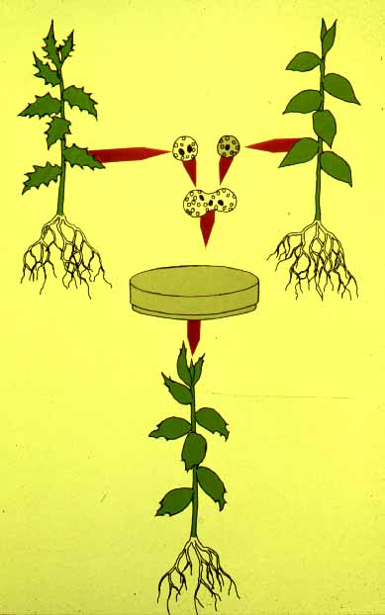
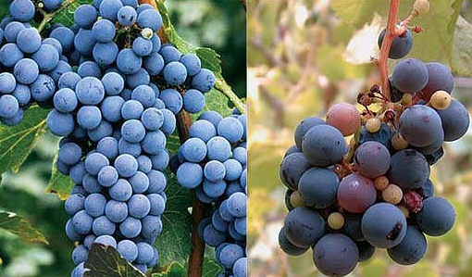
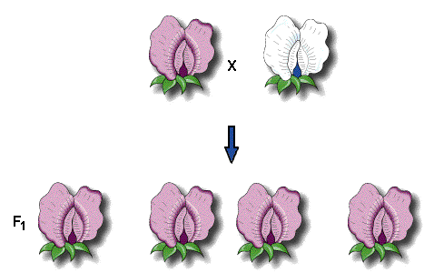


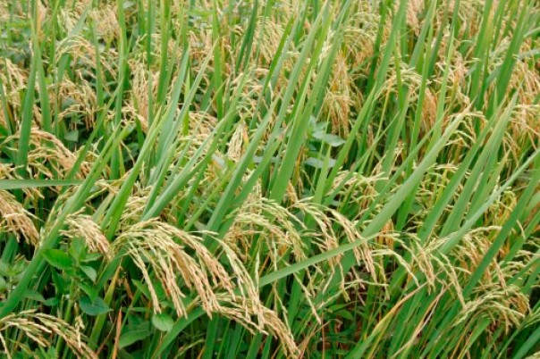
1. Crop variety improvement :
It means finding a crop variety that can give a good yield.
Varieties or strains of crops can be selected by breeding for various characteristics like disease resistance, response to fertilisers, product quality and high yield.
One way of incorporating desirable characters into crops is by Hybridisation.
What is hybridization?
Hybridisation refers to crossing between genetically dissimilar plants.
This crossing can be
Having different genes
1. Intervarietal
Between two varieties
Between two different species of the same genus
2. Interspecific
Between different genera
3. Intergeneric

Slide 4
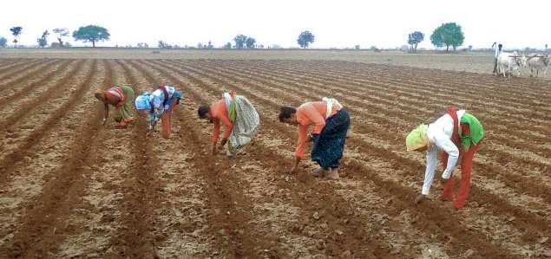
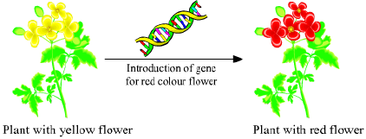
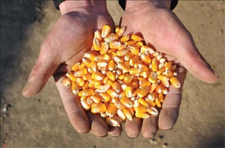
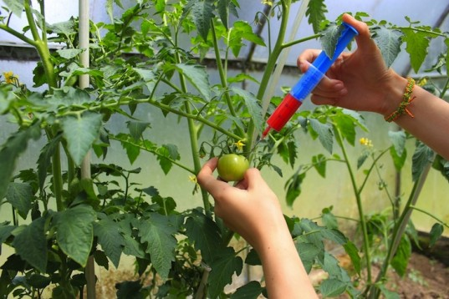
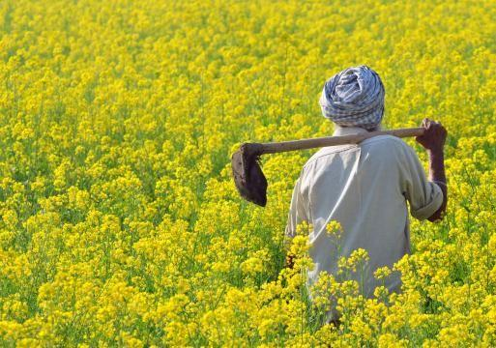
Another way of improving the crop is by introducing a gene that would provide the desired characteristic.
This results in genetically modified crops.
For new varieties of crops to be accepted, it is necessary that the variety produces high yields under different conditions that are found in different areas.
Farmers would need to be provided with good quality seeds of a particular variety, that is, the seeds should be all of the same variety and germinate under the same conditions.
Let us see some of the factors for which variety improvement is done:

Slide 5
1. Higher yield :
To increase the productivity of crop per acre

Slide 6
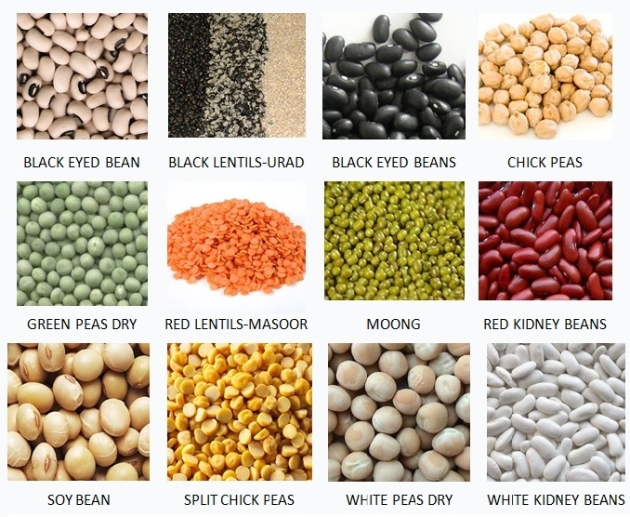
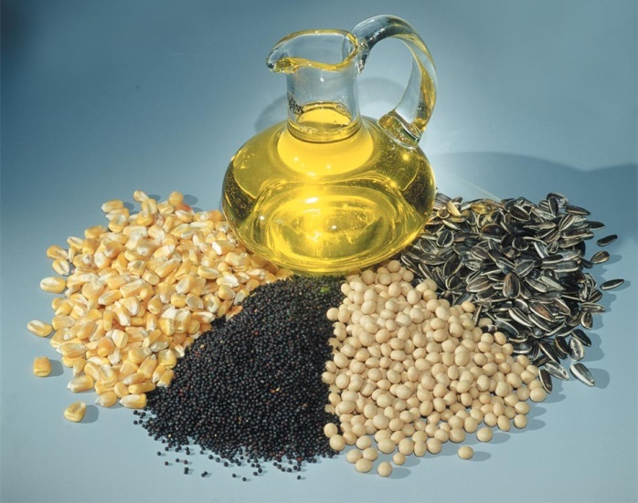
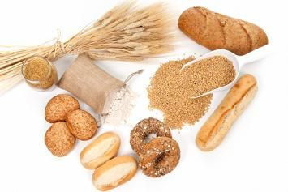
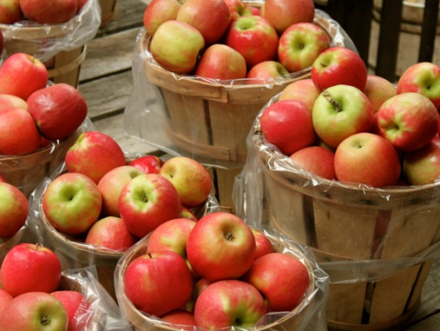
2. Improved quality :
The quality considerations of crop products vary from crop to crop.
For e.g. Baking quality is important in wheat.
Protein quality in pulses.
As wheat is used in making bread, chapatis, biscuits, cakes etc.
As pulses provide us with proteins
Oil quality in oil seeds
As oil seeds are rich sources of oils
Preserving quality in fruits and vegetables
so that they can be preserved for a longer time

Slide 7
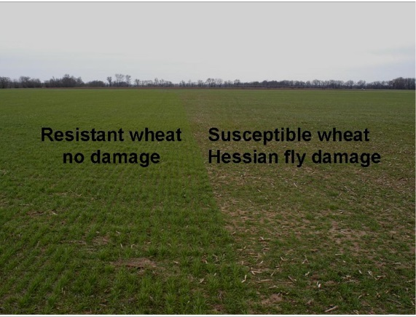
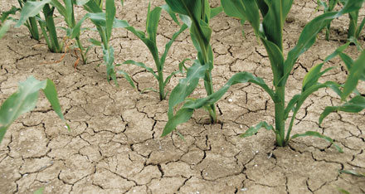
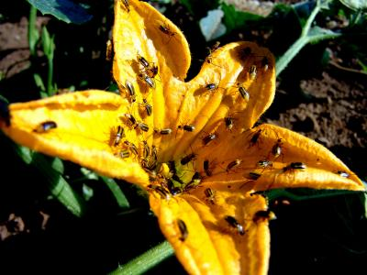
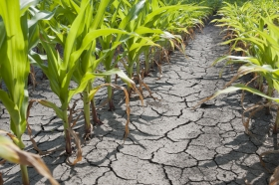
3. Biotic and abiotic resistance :
Crop production can go down due to biotic and abiotic factors under different situations.
drought, salinity, water logging, heat, cold and frost
diseases, insects and nematodes (worms).
Varieties resistant to these factors can improve crop production.

Slide 8
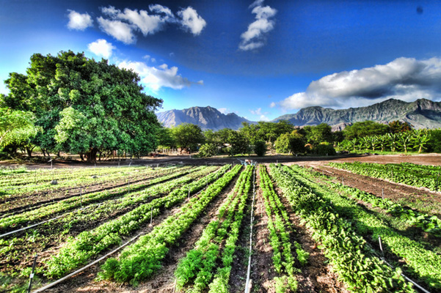
4. Wider adaptability :
It will help in increasing crop production under different environmental conditions.
one variety can be grown in different climatic conditions in different areas.

Slide 9
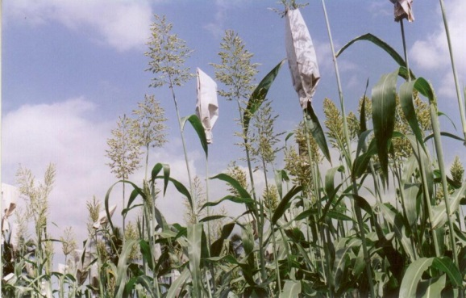
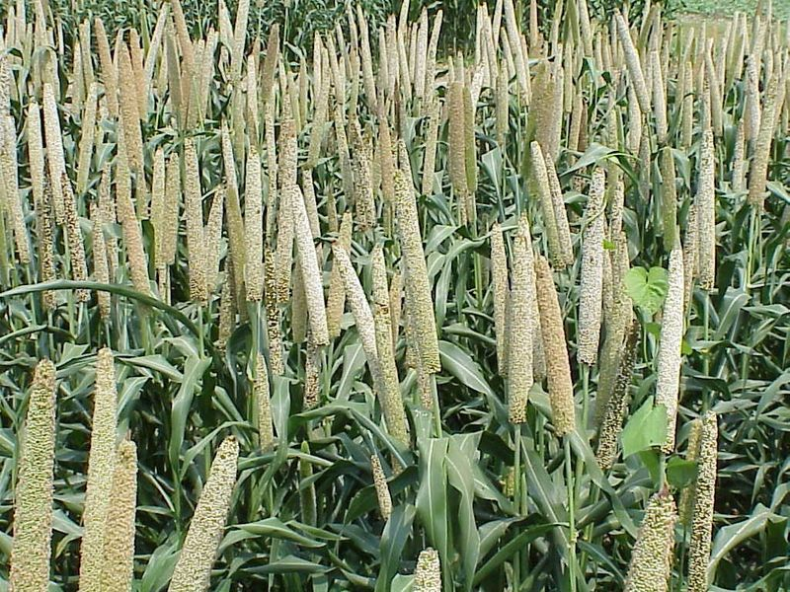
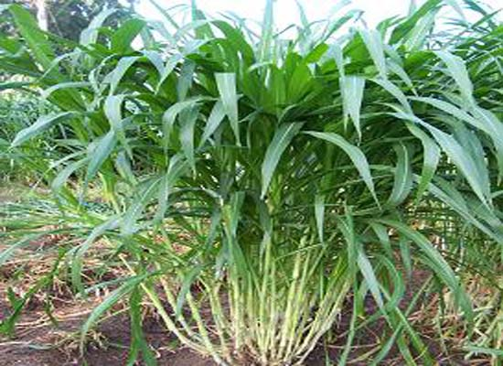
5. Desirable agronomic characteristics :
E.g. Tallness and profuse branching are desirable characteristics for fodder crops.
So that less nutrients are consumed by these crops.
Dwarfness is desired in cereals.

